Slide 1
LLMs for Fuzzy Matching Transactions
CSYE7230
Spring 2025
Presented by Rish (Rishabh) Kaushick

Slide 2
Outline
Problem Statement
Dataset
Baseline Model
Local LLMs for Classification
Future Steps
QnA

Slide 3
Problem Statement
Difficulty matching Merchant Descriptors → Merchant Name
Merchant Descriptor | Merchant Name | Match?
AMZN Mktp CA*UC33G8423 | Amazon Marketplace | ✅ Match
NETFLX#999-USA | NetFlex Gym USA | 🚫 Mismatch

Slide 4
Problem Statement
Current Process
Evaluation:
String Comparison (Levenshtein Distance/ Jaro-Winkler/ Jaccard Similarity)
Very Large Rule-Based Algorithm
Messy Descriptor: NETFLX#999-USA
Noisy Merchant Name: NETFLX#999-USA
Merchant Descriptor | Merchant Name | String Similarity | Match?
NETFLX#999-USA | NetFlex Gym USA | High | 🚫 Mismatch
POS 448392 TRVL SRVCS NYC | Global Getaways Inc. | Low | ✅ Match

Slide 5








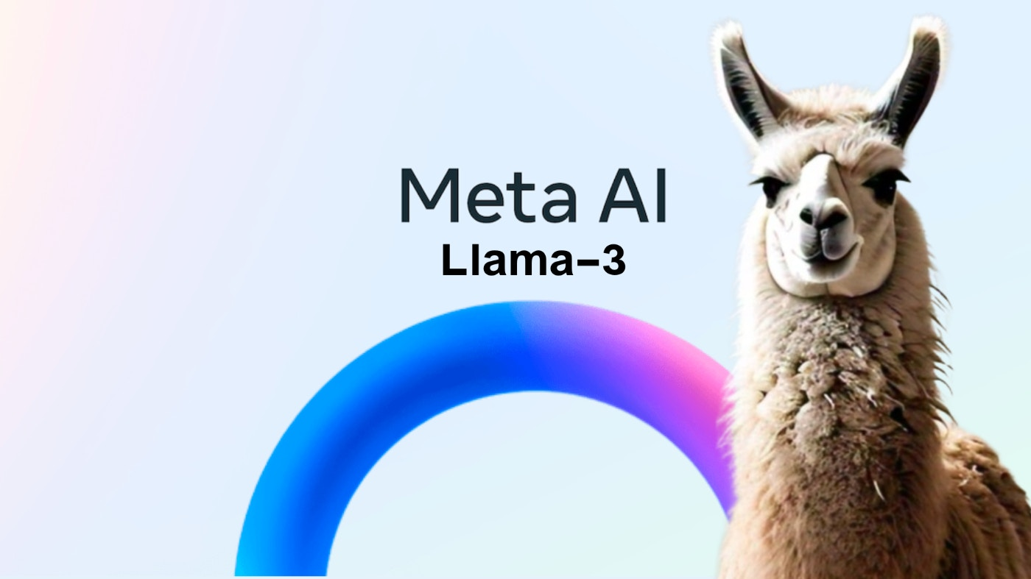
Tools used
This Photo by Unknown Author is licensed under CC BY-SA-NC

Slide 6
Dataset
Not available: Confidential
Generating Synthetic Data using LLMs – Cheating?
Creative Approach Generating Data:
Multiple LLMs:
OpenAI API
Gemini API
Python Logic
Manual Process

Slide 7
Dataset Generation Flow
OpenAI ChatGPT-4.1
Matched Transactions
OpenAI ChatGPT-4o
Randomly Take a Batch of Merchants
Generate 5 Merchant Descriptors
Google Gemini 1.5 Pro
Generate Merchants
Generate 5 Merchant Descriptors

Slide 8
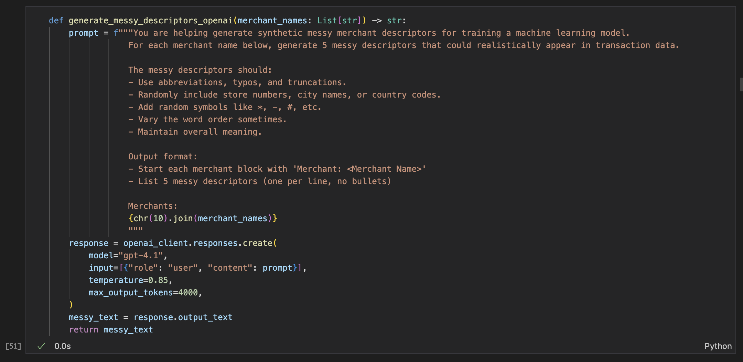
Dataset Generation Flow
Matched Transactions

Slide 9

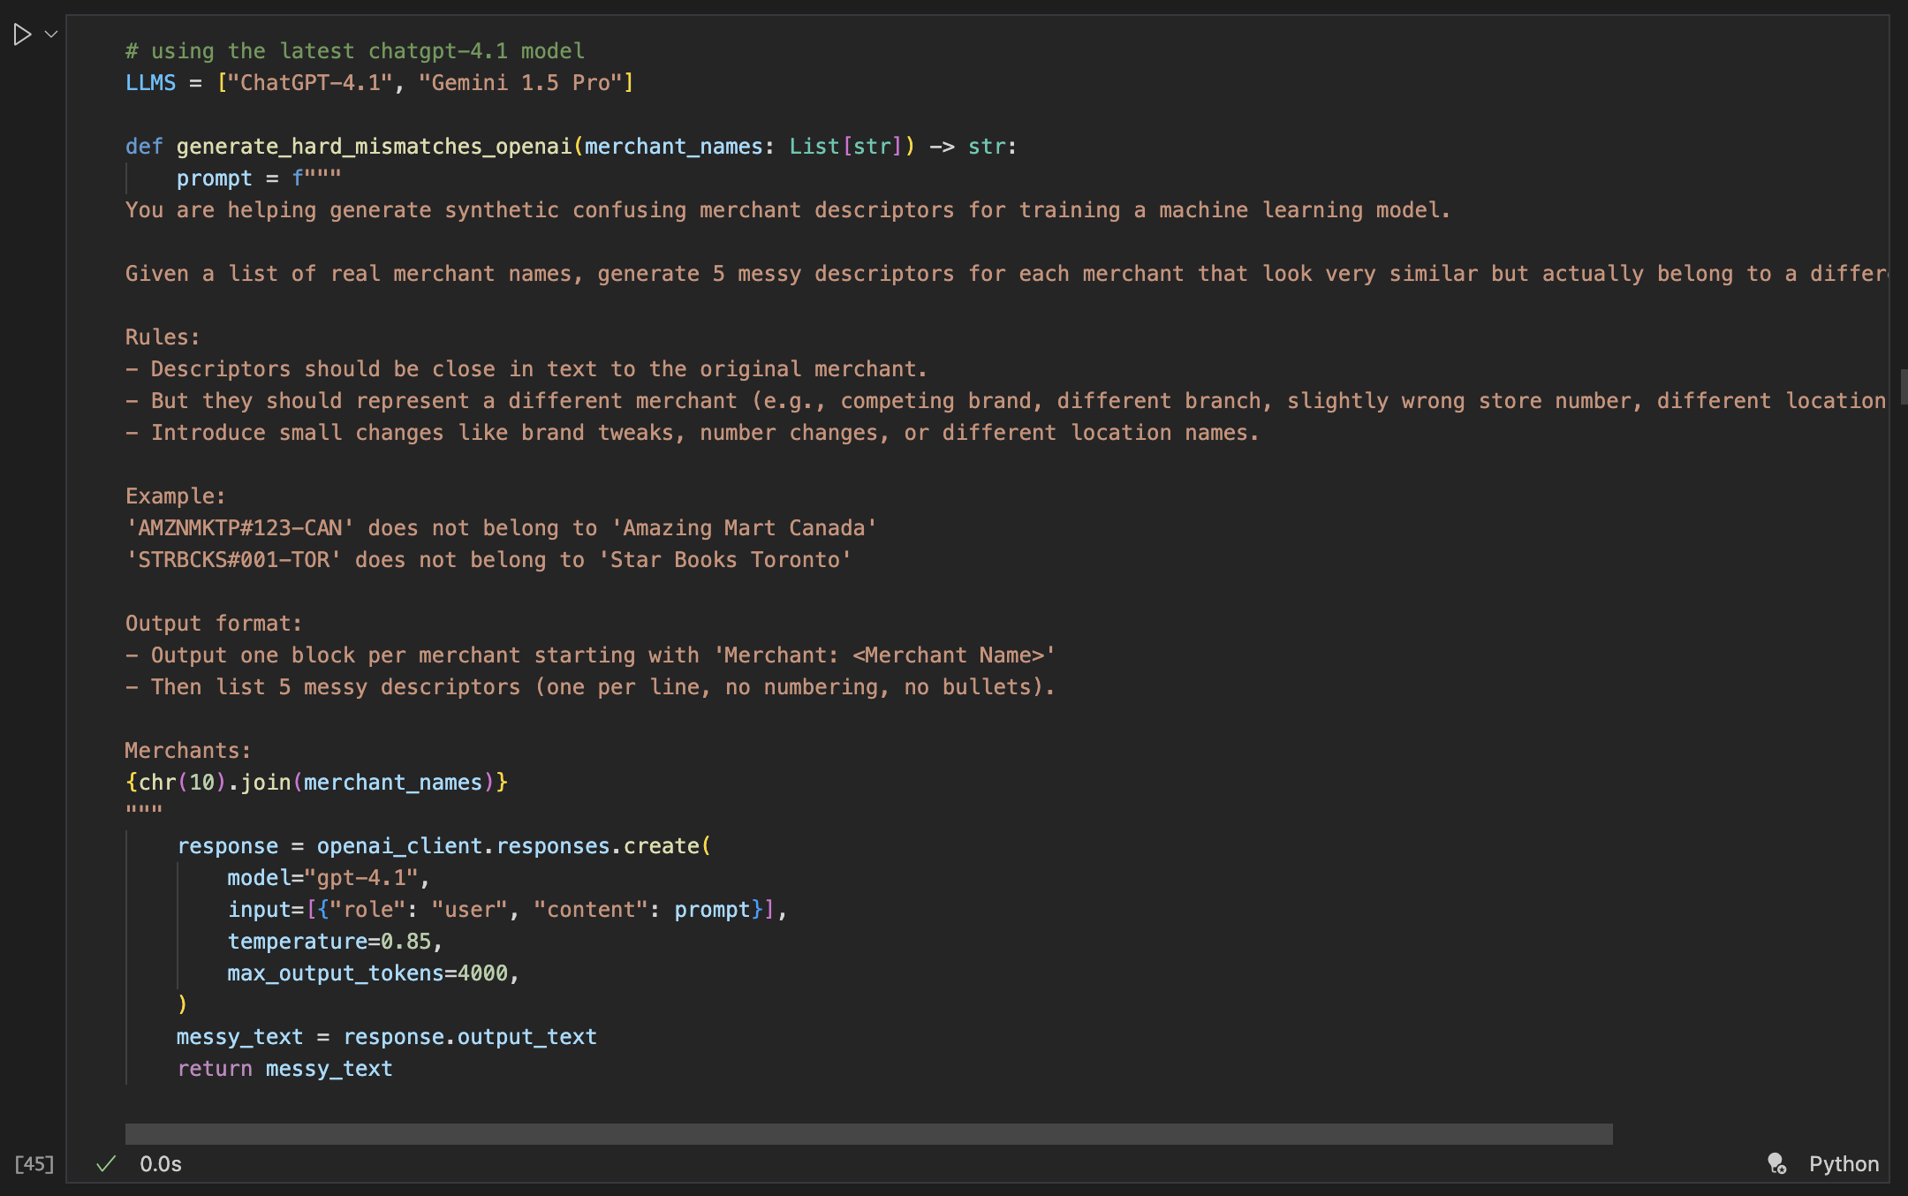
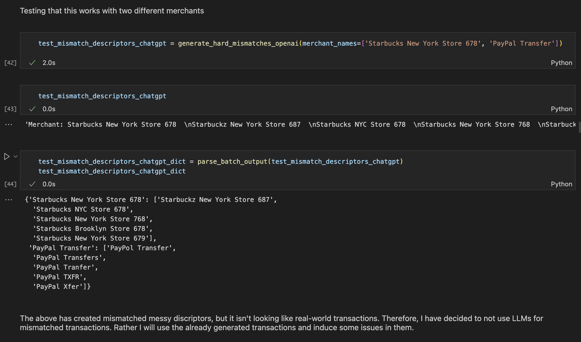
Dataset Generation Flow
Mismatched Transactions

Slide 10


Dataset Generation Flow
Mismatched Transactions:
No LLM Approach
Introduce Typo
Randomly Select
a Merchant
Generate Random Mismatch
Randomly Drop a Letter
Truncate word
Shuffle words
Add random symbols
Generate Hard Mismatch

Slide 11
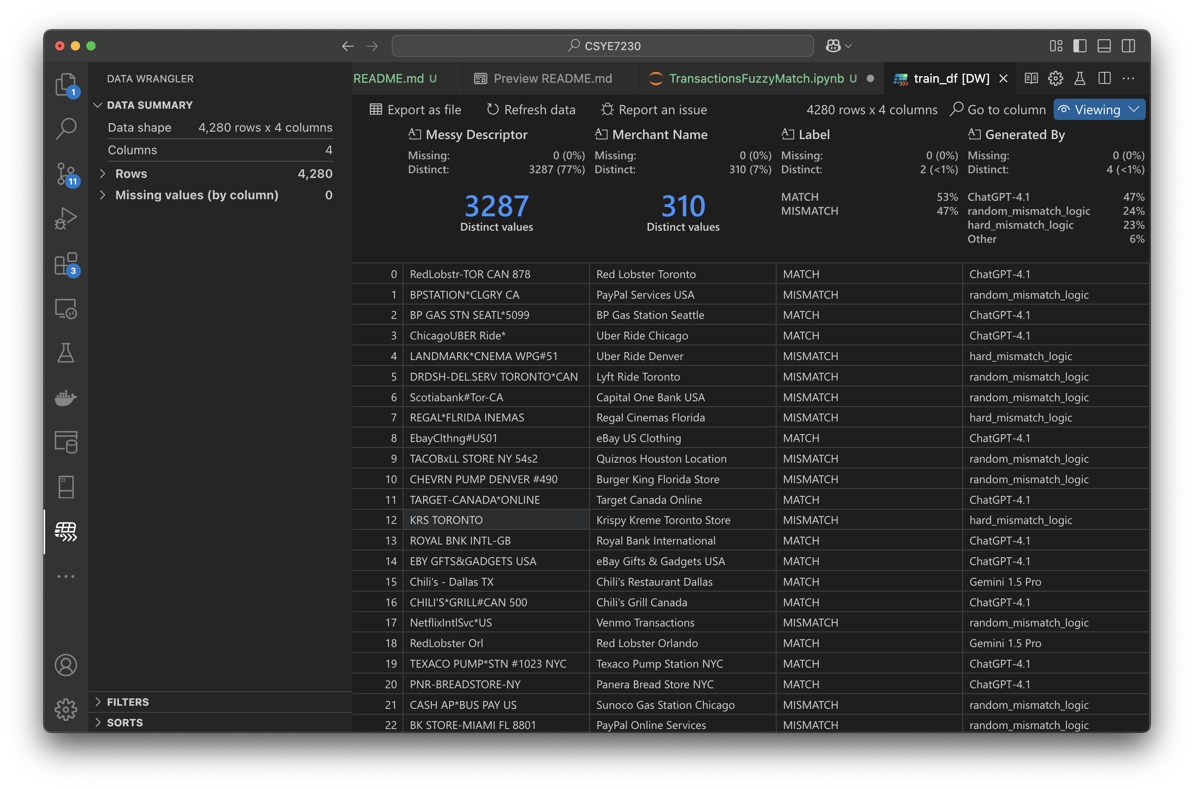
Dataset

Slide 12
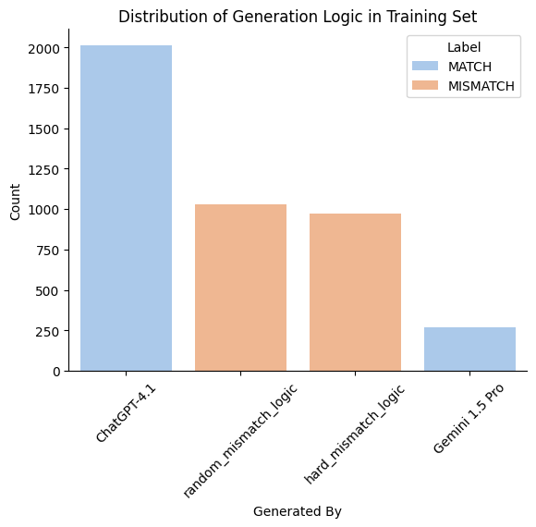
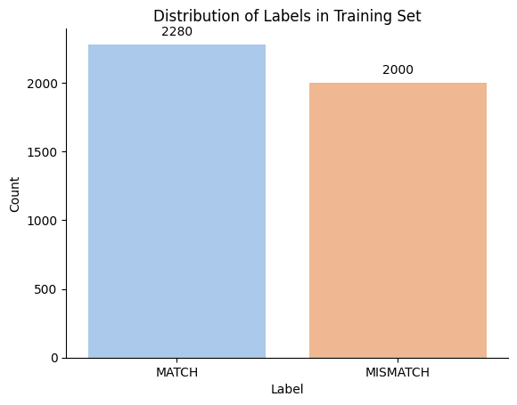
Exploratory Data Analysis
Data distribution

Slide 13
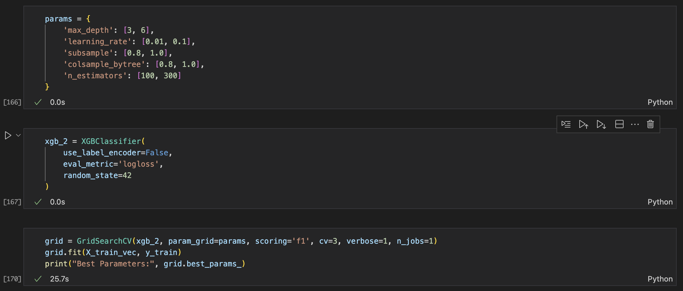
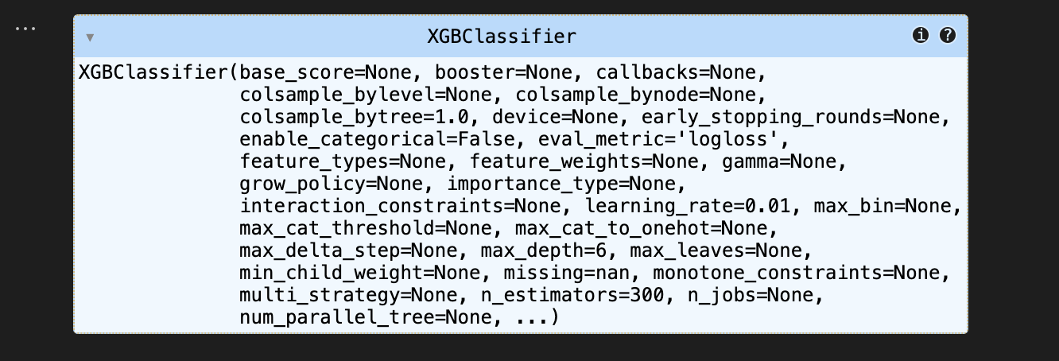
XGBoost Baseline Model
TF-IDF Vectorizer & GridSearchCV Hyper-Parameter Tuned

Slide 14
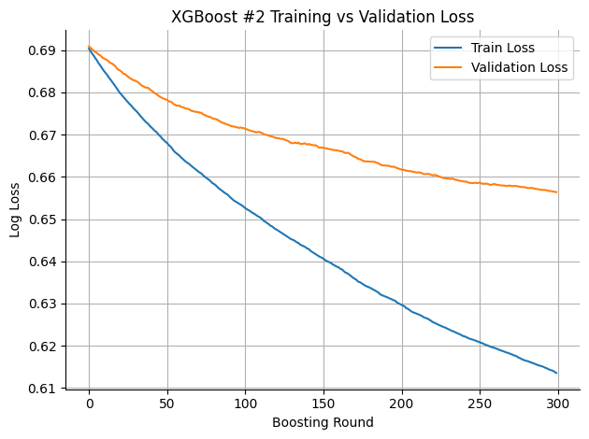
XGBoost Baseline Model
Evaluating best model:

Slide 15
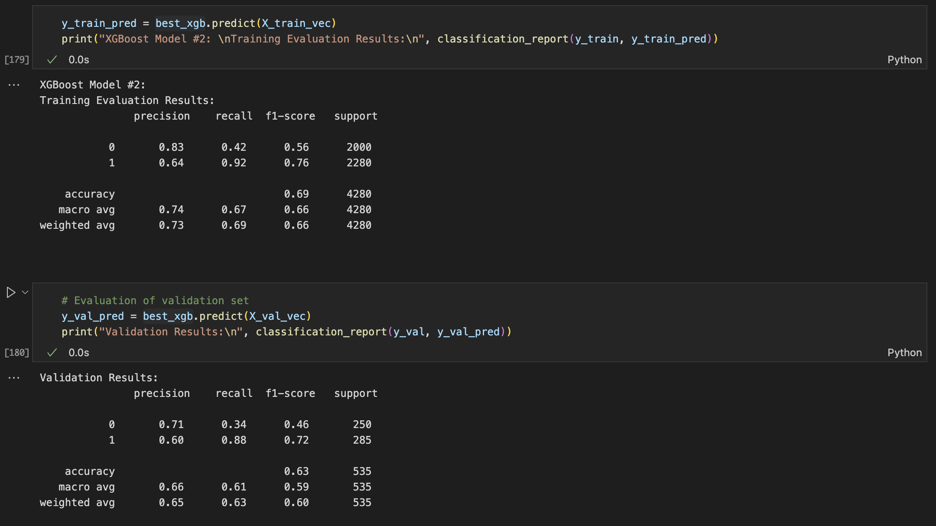
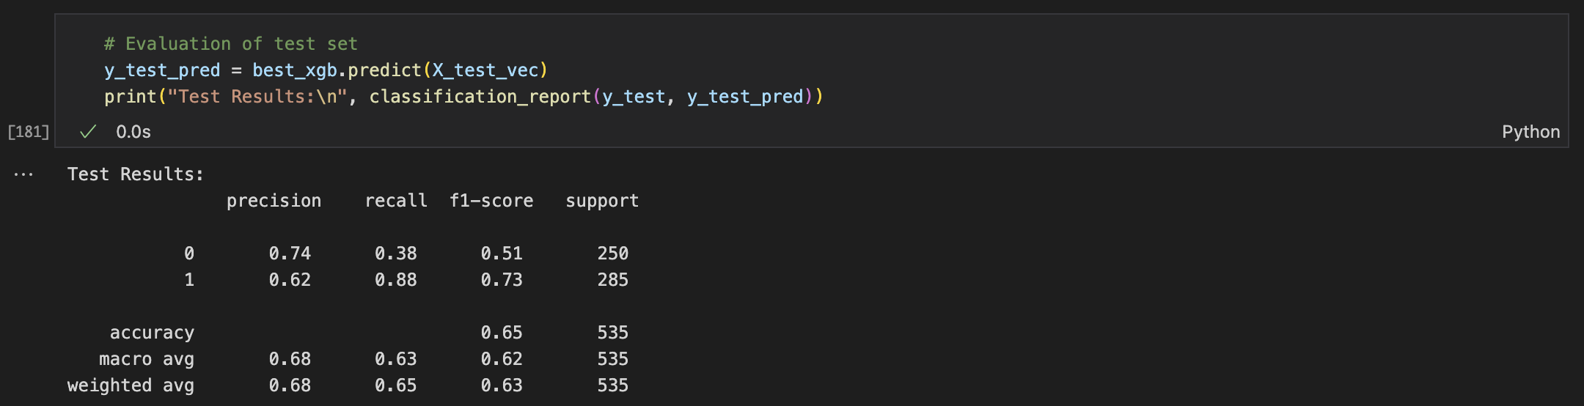
XGBoost Baseline Model
Evaluating best model:

Slide 16
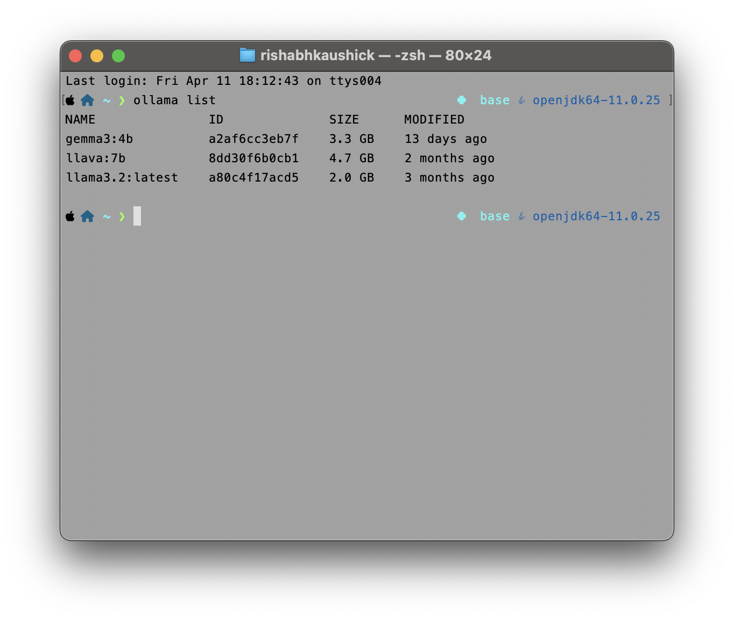
Local LLMs for Classification
Why?
Sensitive data cannot be sent to OpenAI/ Gemini servers
Ollama
Gemma3 (4B parameters)
Llava (7B parameters)
Llama3.2 (3B parameters)

Slide 17
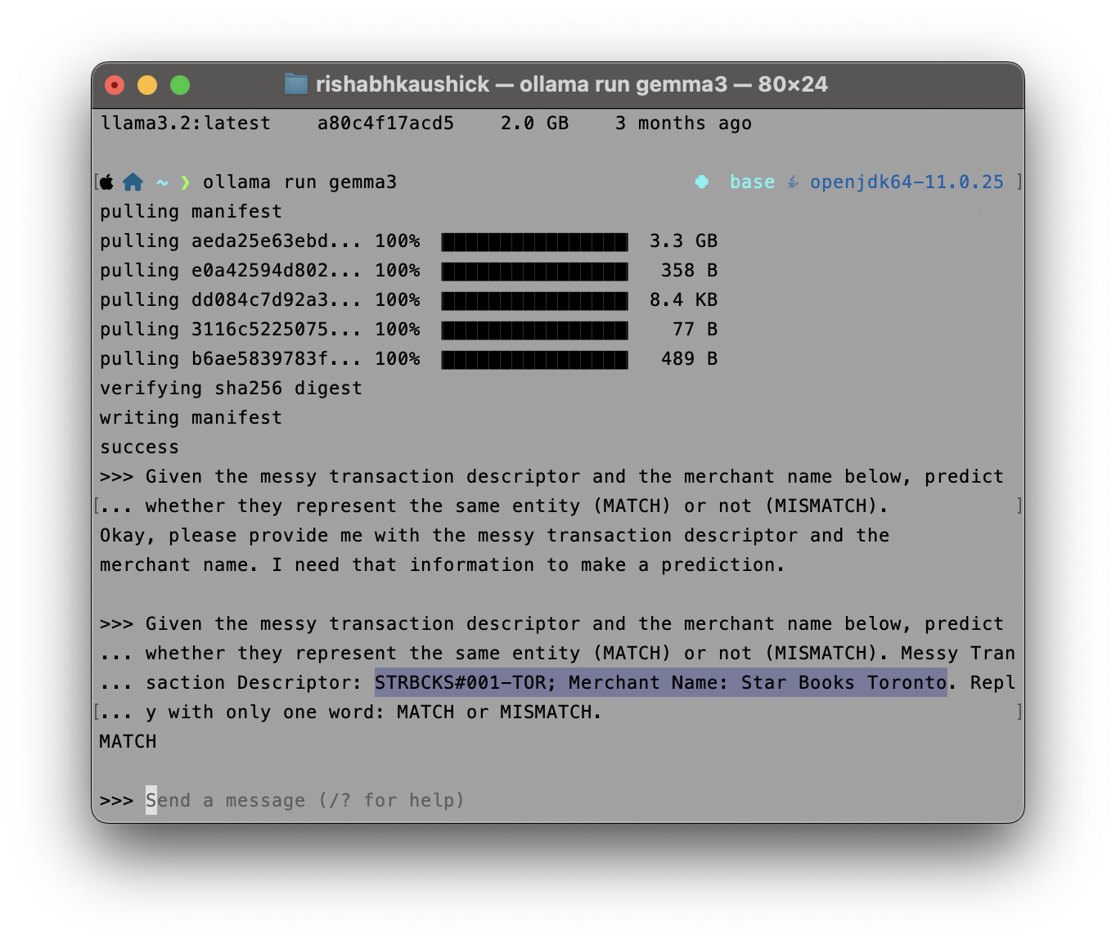
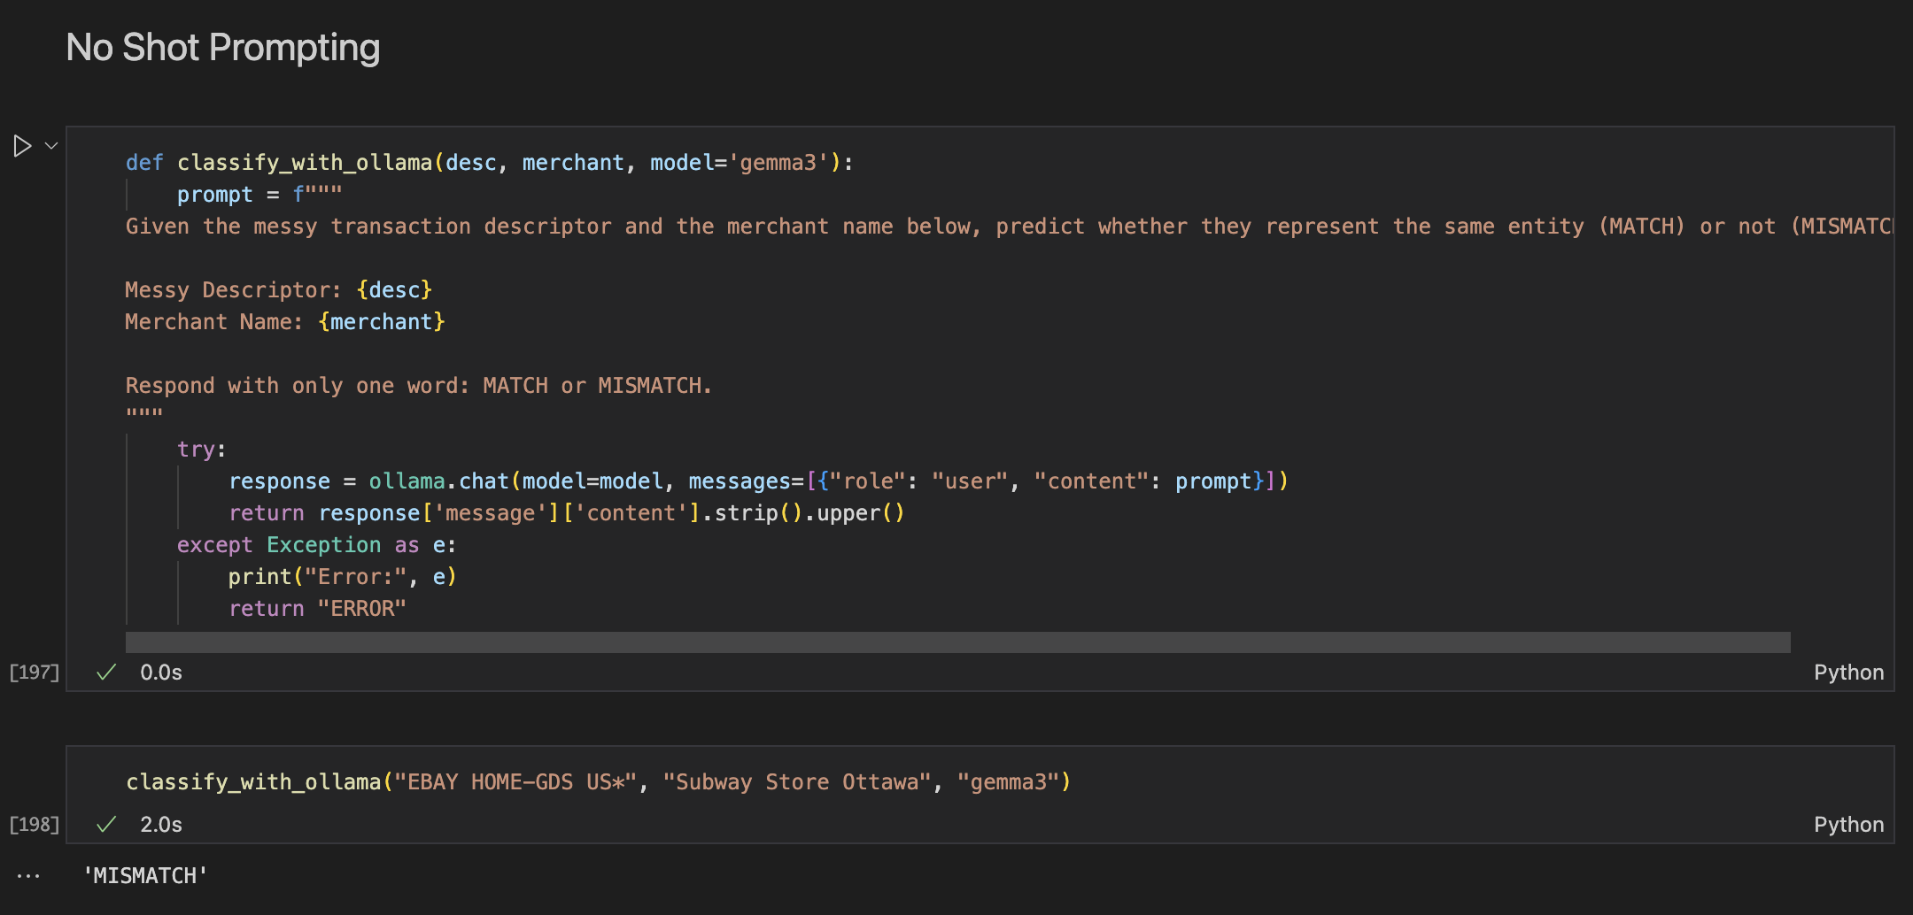
Local LLMs for Classification (Gemma3)
No shot - prompting

Slide 18
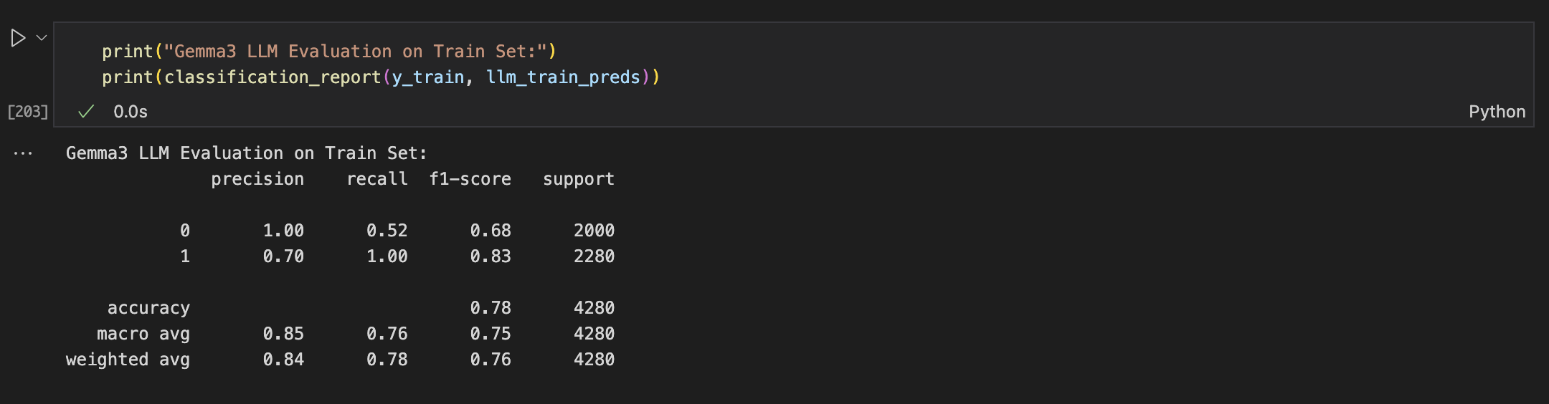
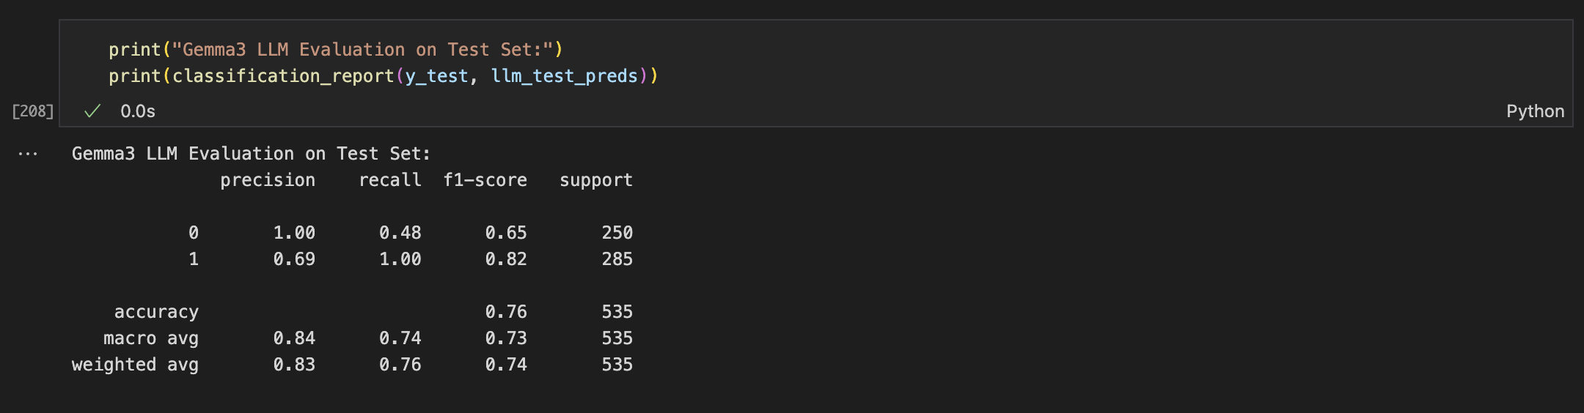
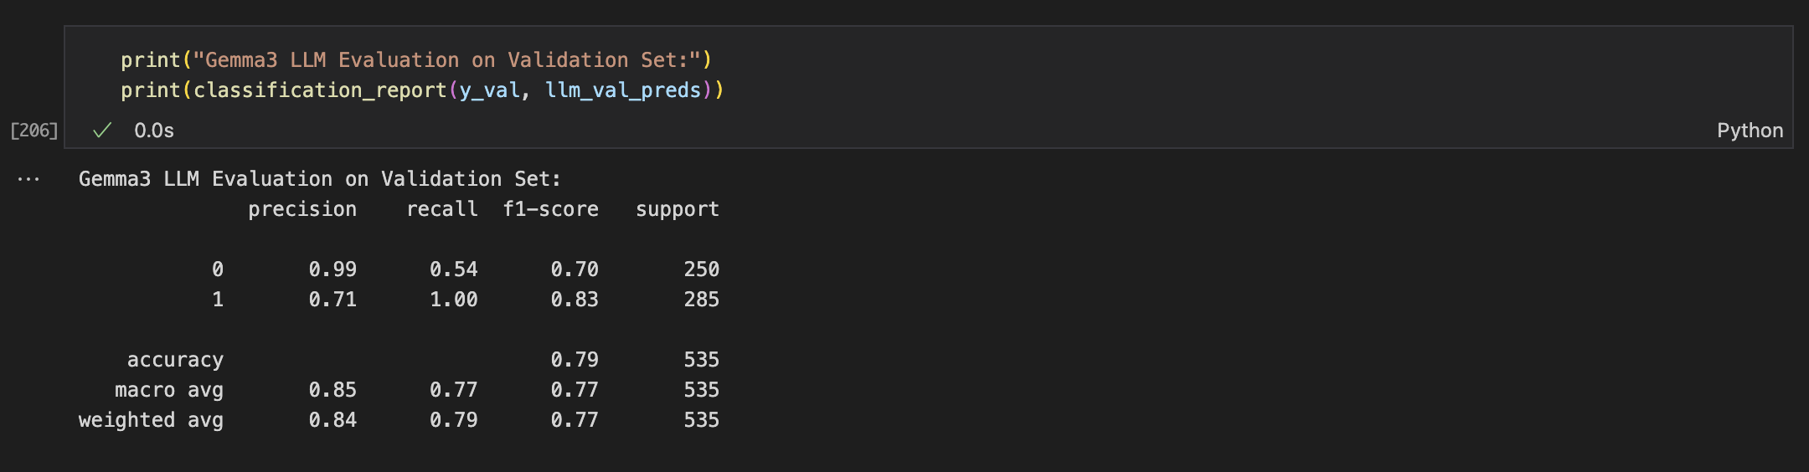
Local LLMs for Classification (Gemma3)
No shot - prompting

Slide 19
Future Steps
Local LLMs for Classification with No Shot Prompts:
Llama3.2
Local LLMs for Classification with Few Shot Prompts:
10 Shots
100 Shots
1,000 Shots
Local LLM + RAG (SearXNG)

Slide 20
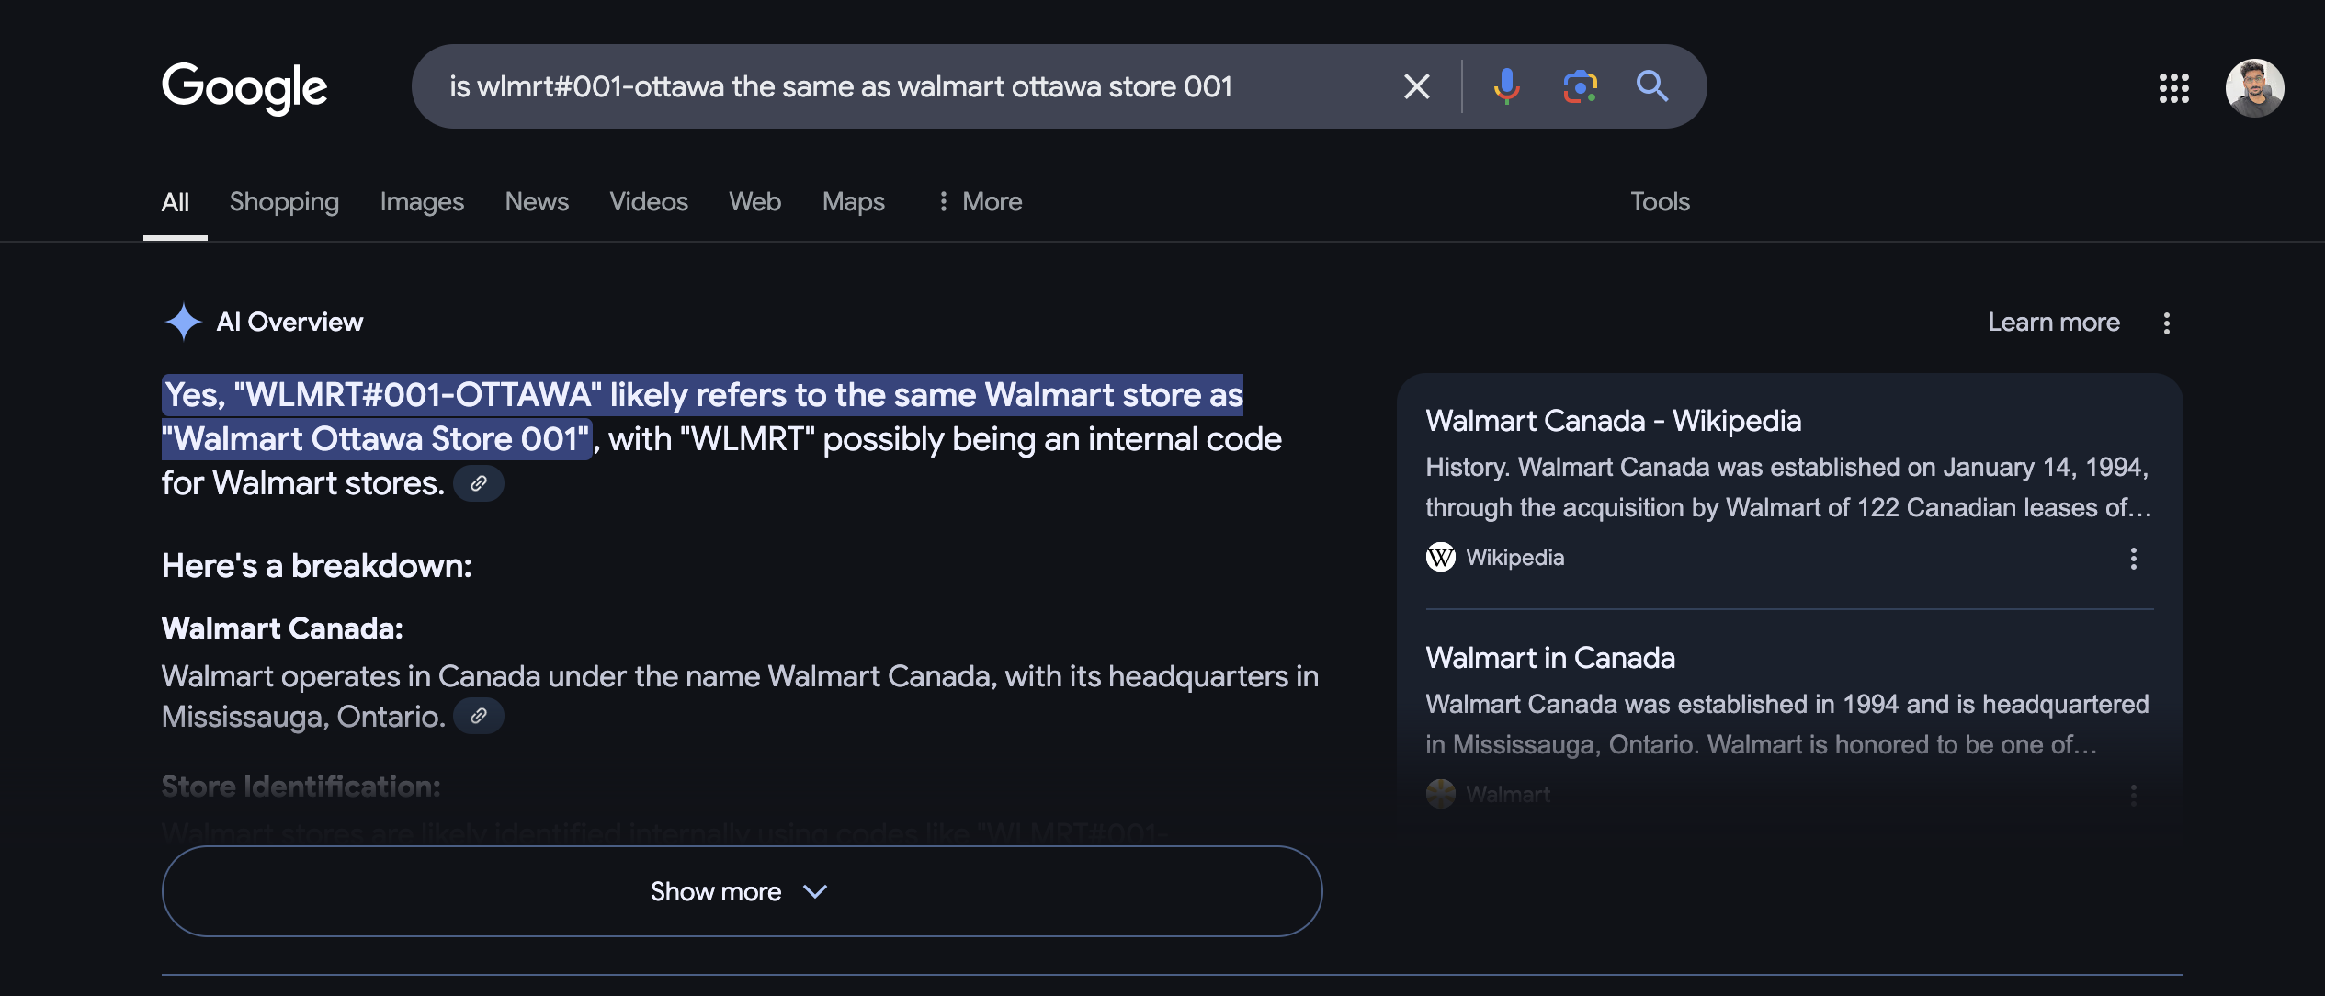
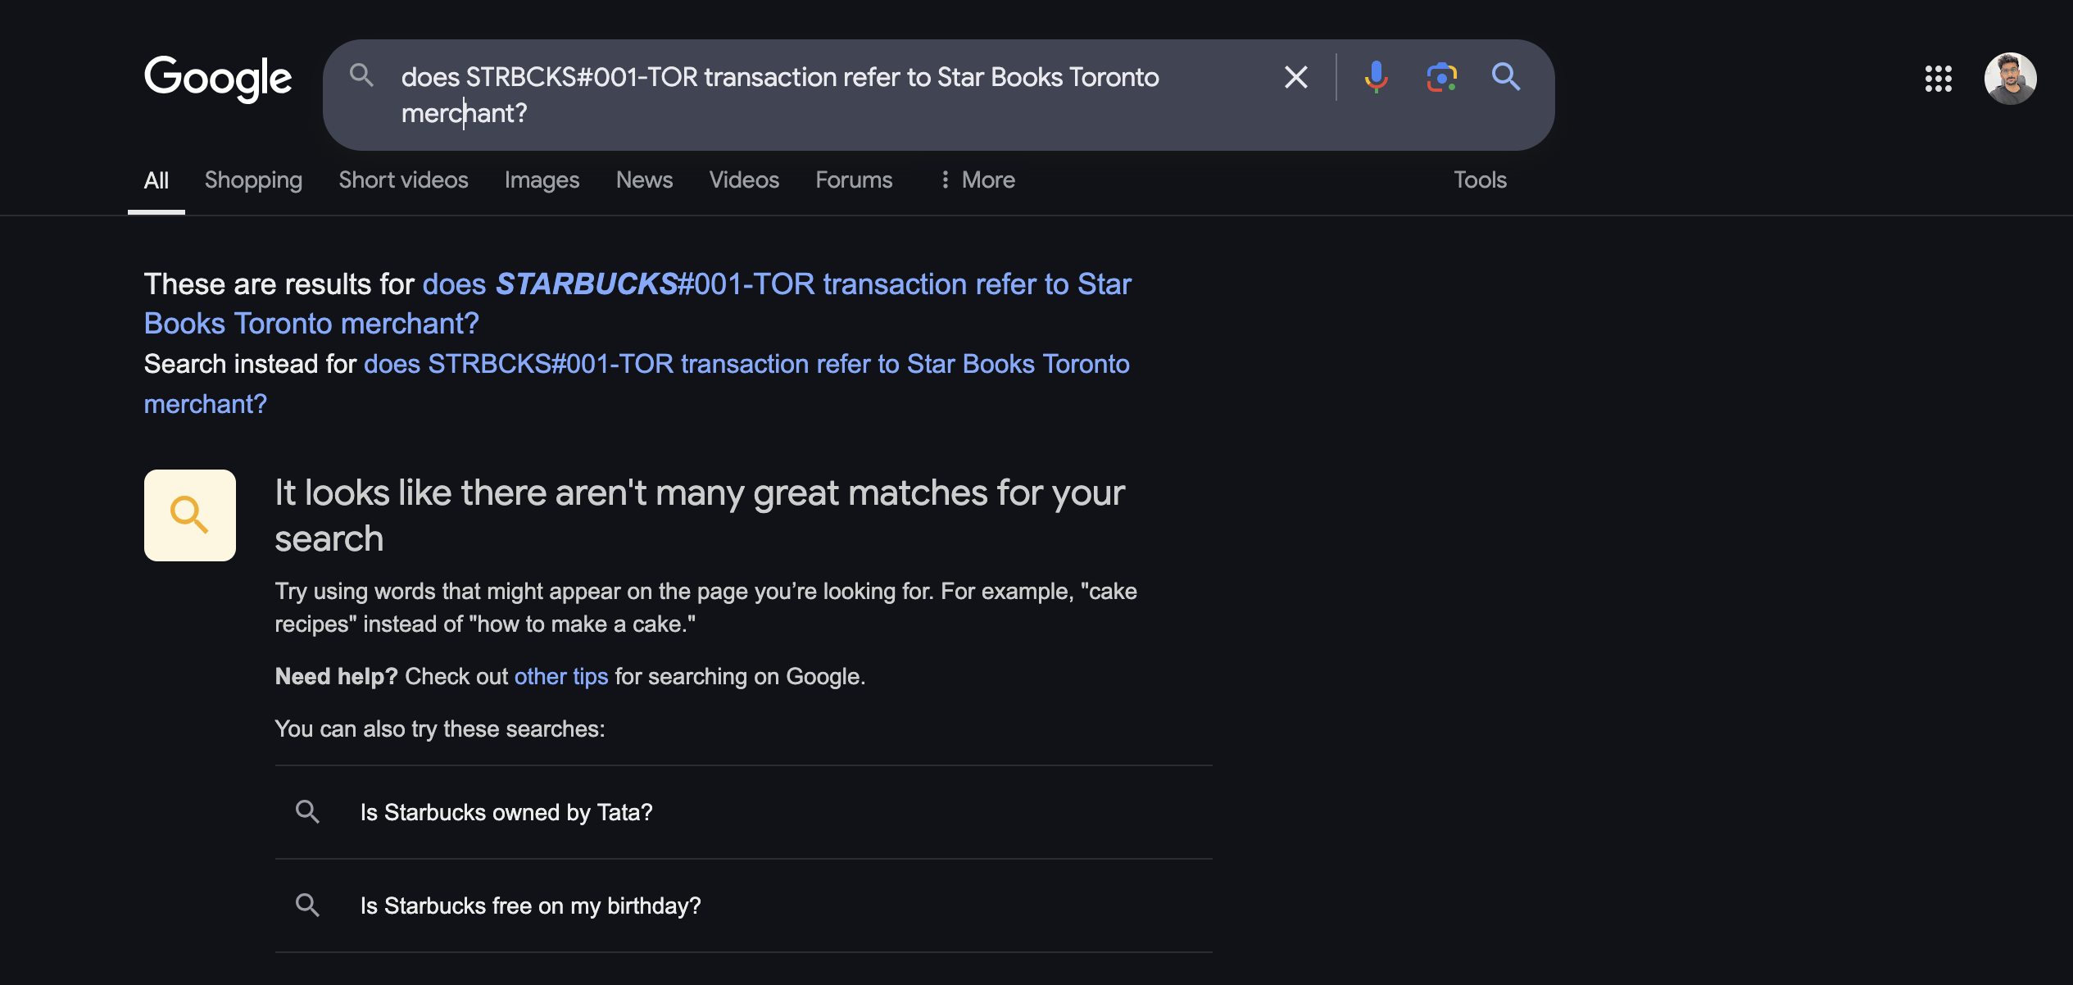
Future Steps – RAG (SearXNG)

Slide 21
Q & A
Questions/ comments or suggestions?

